Slide 1
The 2nd Law of Thermodynamics
In general, Energy flows spontaneously from hotter to cooler object
System moves from less probable state to more probable state
The spontaneous flow of energy stops when a system is at, or very near, its most likely macrostate (the macrostate with the greatest multiplicity).
Most probable macro state has the greatest multiplicity
Law of increase in multiplicity
One of the versions of 2nd Law of Thermodynamics
NOTE:
Real systems have like 10²³ particles (not few hundreds like in the example)
To tackle the problem analytically, we have to use math approximations.

Slide 2
Concepts of Statistical Mechanics
The macrostate is specified by a sufficient number of macroscopically measurable parameters (for an Einstein solid – N and U).
The microstate is specified by the quantum state of each particle in a system (for an Einstein solid – # of the quanta of energy for each of N oscillators)
The multiplicity is the number of microstates in a macrostate. For each macrostate, there is an extremely large number of possible microstates that are macroscopically indistinguishable.
The Fundamental Assumption: for an isolated system, all accessible microstates are equally probable.
The probability of a macrostate is proportional to its multiplicity. This will be sufficient to explain irreversibility.

Slide 3
Stirling’s Approximation for N! (N >> 1)
Multiplicity depends on N!; we need an approximation for ln(N!):
or
More accurately:
Stirling’s
approx.
Check:
because ln N << N for large N

Slide 4
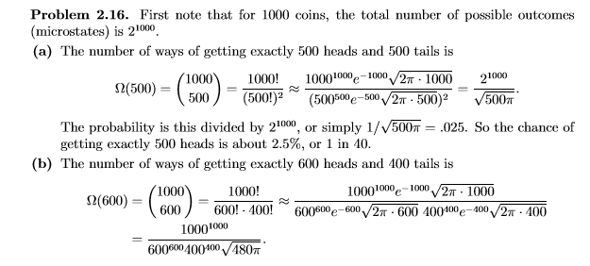
Problem 2.16.
Suppose you flip 1000 coins.

Slide 5
Multiplicity of large Einstein’s solids
N is large
$$Ω\left(N,q\right)=\left(\begin{matrix}q+N−1 \\ q\end{matrix}\right)=\frac{\left(q+N−1\right)!}{q!\left(N−1\right)!}≈\frac{\left(q+N\right)!}{q!N!}$$
Stirling’s Approximation
$$\ln{Ω}=\ln\left(q+N\right)!−lnq!−lnN!$$
$$=[\left(q+N\right)\ln\left(q+N\right)−q−N]−[qlnq−q]−[NlnN−N]$$
$$lnΩ(N,q)=\left(q+N\right)\ln\left(q+N\right)−q lnq−N lnN$$
---- Eq. (1)
Case: q >> N
$$\ln\left(q+N\right)=ln⁡(q\left(1+\frac{N}{q}\right)=lnq+ln⁡(1+\frac{N}{q})≈lnq+\frac{N}{q}$$
Plugging this back to Eq (1)
Since $\ln\left(1+x\right)≈x, when x≫1, Taylor^{′}s expansion$
$$lnΩ(N,q)=\left(q+N\right)[ln{q+\frac{N}{q}]}−q lnq−N lnN$$
$$=qlnq+N+Nlnq+\frac{N^{2}}{q}−q lnq−N lnN=Nlnq−NlnN+N(1+\frac{N}{q})$$
$$lnΩ=N\left(lnq−lnN\right)+N\left(1+\frac{N}{q}\right)=Nln\left(\frac{q}{N}\right)+N$$
Since $\frac{N}{q}≪1⇒1+\frac{N}{q}≈1$
➔ $Ω=e^{Nln(\frac{q}{N})}∙e^{N}={(\frac{eq}{N})}^{N}$
$Ω={(\frac{eq}{N})}^{N}$
For large Einstein’s solid when q >> N

Slide 6
Multiplicity of a Large Einstein Solid
For high-temperature limit q >> N
$$Ω(N,q)≈e^{N\ln{\frac{q}{N}}}e^{N}={\left(\frac{eq}{N}\right)}^{N}$$
For low-temperature limit q << N
$$Ω(N,q)={\left(\frac{eN}{q}\right)}^{q}$$
P: 2.17
One of Assignment#4

Slide 7
Sharpness of the Multiplicity Function
Ω _{AB}
How sharp is the peak? Let’s consider small deviations from the maximum for two identical sub-systems:
2Δq
q/2
q_{A}
where q_{A} and q_{B} are the numbers of energy units in solids A and B, with q_{A} + q_{B} = q. The above function will have a sharp peak at q_{A} = q_{B} = q/2, where the energy is distributed equally between the solids. The height of this peak is a very large number.
To determine how the graph looks near the peak, use
$$q_{A}=\frac{q}{2}+x$$
$$q_{B}=\frac{q}{2}−x$$
(x << 1)
Notes:
7

Slide 8
Sharpness of the Multiplicity Function
Ω _{AB}
2Δq
q/2
q_{A}
After some manipulation, this becomes (page 64 – 65)
$$Ω_{AB}= {\left(\frac{e}{N}\right)}^{2N}{\left(\frac{q}{2}\right)}^{2N}e^{−N{\left(2x/q\right)}^{2}}=Ω_{Max}e^{−N{\left(2x/q\right)}^{2}}$$
a Gaussian function
The multiplicity falls off to 1/e of its value when
$${Ω=\frac{1}{e}Ω}_{Max}$$
$FWHM=2\left(\frac{q}{2√N}\right)$= $\left(\frac{q}{√N}\right)$
$$Δq=\frac{q}{2\sqrt{N}}$$
Notes:
8

Slide 9
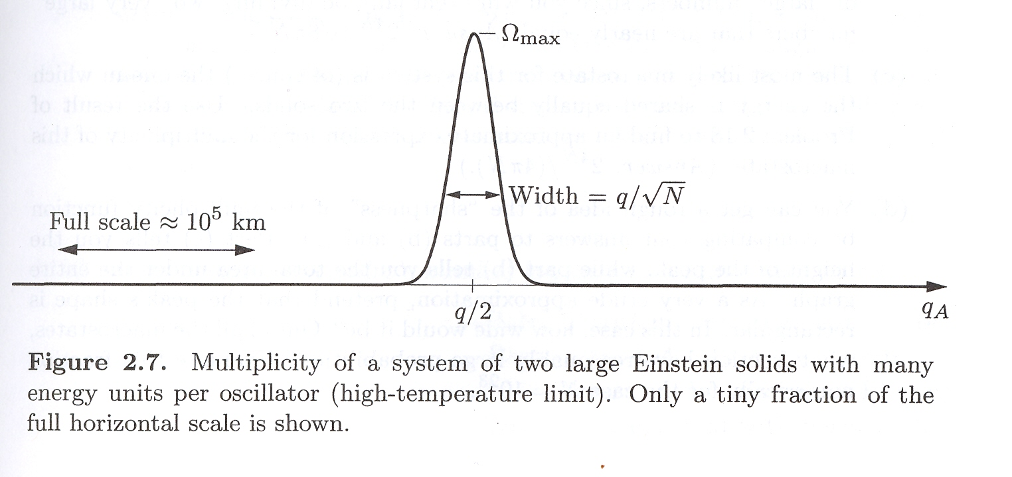
When two Einstein solids are in thermal equilibrium with each other, any random fluctuations away from the most likely macrostate will be utterly unmeasurable.
To measure such fluctuations, we would have to measure the energy to an accuracy of ten significant figures.
Once the system has had time to come to thermal equilibrium (all microstates are equally probable), we might as well assume it is in the most likely macrostate.
Thermodynamic limit = The limit where the system becomes infinitely large, so that measurable fluctuations away from the most likely macrostate never occur.

Slide 10
Implications: Irreversibility!
The vast majority of microstates are in macropartitions close to the most probable one (in other words, because of the “narrowness” of the macropartition probability graph). Thus,
If the system is not in the most probable macropartition, it will rapidly and inevitably move toward that macropartition. The reason for this “directionality” (irreversibility): there are far more microstates in that direction than away. This is why energy flows from “hot” to “cold” and not vice versa.
It will subsequently stay at that macropartition (or very near to it), in spite of the random shuffling of energy back and forth between the two solids.
When two macroscopic solids are in thermal equilibrium with each other, completely random and reversible microscopic processes (leading to random shuffling between microstates) tend at the macroscopic level to push the solids inevitably toward an equilibrium macropartition (an irreversible macro behavior). Any random fluctuations away from the most likely macropartition are extremely small !

Slide 11
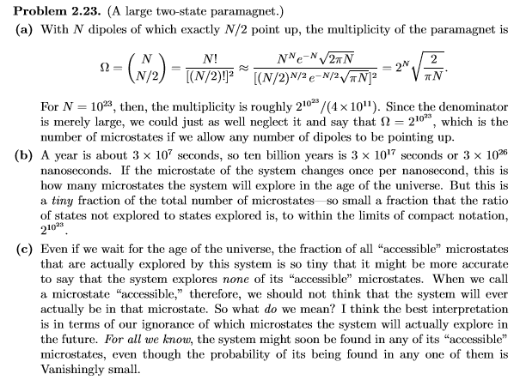

Slide 12
Multiplicity (Entropy) and Disorder
In general, we can say that small multiplicity implies “order”, while large multiplicity implies “disorder”. An arrangement with large Ω could be achieved by a random process with much greater probability than an arrangement with small Ω.
↑↑↑↑↑↑↑↑↑↑↑↑
↑↓↓↑↓↑↑↓↓↓↑↓↑
small Ω
large Ω
General statement of the 2nd law of thermodynamics
Any large system in equilibrium will be found in the macrostate with the greatest multiplicity (aside from fluctuations that are normally too small to measure).
Multiplicity tends to increase.

Slide 13
Entropy
of a system in a given macrostate (N,U,V...):
Units ?
The entropy is a state function, i.e. it depends on the macrostate alone and not on the path of the system to this macrostate.
J/K
Entropy is just another (more convenient) way of talking about multiplicity.
Convenience?
Reduces ridiculously large numbers to manageable numbers
Examples: for N ~ 10²³, , ln Ω ~ 10²³, being multiplied by k_{B} ~ 10⁻²³, it gives S ~ 1J/K.
The “inverse” procedure:
The entropy of a certain macrostate is 4600k_{B}. What is the multiplicity of the macromacrostate?
If a system contains two or more interacting sub-systems having their own distinct macrostates, the total entropy of the combined system in a given macropartition is the sum of the entropies of the subsystems they have in that macropartition:
Ω _{AB} = Ω _{A} × Ω _{B} × Ω _{C} × .... ⇒ S _{AB} = S _{A} + S _{B} + S _{C} + ...

Slide 14
Multiplicity (Entropy) and Disorder
General statement of the 2nd law of thermodynamics
Any large system in equilibrium will be found in the macrostate with the greatest multiplicity (aside from fluctuations that are normally too small to measure).
Multiplicity tends to increase.
Any large system in equilibrium will be found in the macrostate with the greatest entropy (aside from fluctuations that are normally too small to measure).
Entropy tends to increase.

Slide 15
The Second Law of Thermodynamics
An isolated system, being initially in a non-equilibrium state, will evolve from macropartitions with lower multiplicity (lower probability, lower entropy) to macropartitions with higher multiplicity (higher probability, higher entropy). Once the system reaches the macropartition with the highest multiplicity (highest entropy), it will stay there. Thus,
The entropy of an isolated system never decreases.
(An other formulations of the second law of thermodynamics)
Whatever increases the number of microstates will happen if it is allowed by the fundamental laws of physics and whatever constraints we place on the system.
“Whatever” ?
- energy exchange, particles exchange, expansion of a system, etc.

Slide 16
2nd Law of Thermodynamics
States in which direction a process can take place
heat flows spontaneously from a hot to a cold body
heat does not flow spontaneously from a cold to a hot body
heat cannot be transformed completely into mechanical work
it is impossible to construct an operational perpetual motion machine
$$∆S≥0$$

Slide 17
The Second Law of Thermodynamics
Establishing the “arrow of time” is one of the most profound implications of the second law of thermodynamics.
The entropy of the universe does not change for reversible processes and increases for spontaneous processes.
Reversible (ideal):
Irreversible (real, spontaneous):

Slide 18
Entropy of an Ideal Gas
The Sackur-Tetrode equation:
(Monatomic ideal gas)
Example on p.78
1 mole of Helium ≅ 4 amu,
V=0.025 m³, U=3700 J at room temperature and atmospheric pressure.
Find the entropy.
$$9.1{10}^{24}k_{B}=126 J/K$$

Slide 19
The entropy of an ideal gas depends on its volume, energy, and number of particles.
An increase of any of these will increase the entropy.
Example: If the volume changes from V_{i} to V_{f} while U and N are held fixed, the entropy changes by
$$S(N,V,U)=Nk_{B} \left\{\ln\left[\frac{V}{N}{\left(\frac{4πm}{3h^{2}}\frac{U}{N}\right)}^{3/2}\right] +\frac{5}{2}\right\}$$
(U, N fixed)
$$∆S=Nk_{B} ln\frac{V_{f}}{V_{i}}$$
This is the case of isothermal expansion, where the gas pushes on a piston, doing mechanical work, while heat is supplied simultaneously from outside to keep the gas at constant T.
The entropy increase because of the heat input.

Slide 20
Assignment#4 Due 2/24/2022
2.17, 2.19, 2.26, and 2.31 2.33.
Problems for practice on Friday:
2.1, 2.2, 2.5, 2.6, 2.8, 2.28, 2.32, and 2.36.
(These are all problems from this chapter)
Next: Ch 3
Exam 1 Covering Ch 1 through Ch 3
3/4/2022

